Slide 1
RBC count

Slide 2
Principle
The blood is diluted 200 times in a red cell pipette and the cells are counted in the counting chamber.
Knowing the dilution employed, the red cells number in undiluted blood can easily be calculated.

Slide 3
Normal red cell count
The average red cell counts and their ranges are:
Males = (4.75 – 6.0) ${million/mm}^{3}$, (5.0 ${million/mm}^{3}$)
Females = (4.0 – 5.5) ${million/mm}^{3}$, (4.5 ${million/mm}^{3}$)

Slide 4
Normal red cell count
Increased RBC count (polycythemia) is seen in;
Polycythemia vera (primary polycythemia)
Secondary polycythemia
Polycythemia due to hemoconcentration
Physiological polycythemia
Notes:
1. Polycythemia vera (erythremia, or primary polycythemia): A gene abnormality in the early red cells causes them to form more and more cells. Erythropoietin production is not raised, but may be decreased.
2. Secondary polycythemia: Hypoxia due to lung diseases, congenital heart disease, cardiac failure increases the RBC count.
3. Polycythemia due to hemoconcentration: Fluid loss during severe vomiting and diarrhea; and loss of plasma in burns, cause polycythemia. There is no increase in total red cell mass.
4. Physiological polycythemia is seen during residence at high altitudes, and in newborns. Emotional stress and severe exercise may cause a temporary increase in RBC count.

Slide 5
Normal red cell count
Decreased RBC count (anemia) is seen in;
Medications
Genetic conditions
Bleeding
Medical conditions
Nutritional deficiencies
Physiological conditions
Notes:
Medications
There are certain medications that can decrease the red blood cells in the body, MedlinePlus states. These medications include drugs that are used in chemotherapy for treatment of cancers, quinidine, hydantoins and chloramphenicol.
Genetic Conditions
There are some forms of anemia that are genetic and can be inherited, says MayoClinic.com. These include thalassemia, which is caused by a defective protein found in red blood cells. Diseases affecting the immune system that can cause the destruction of blood cells are another cause of low RBC. This condition is called hemolytic anemia, where the body is responsible for producing antibodies which destroy the red blood cells..
Bleeding
Blood loss may be a cause of anemia, according to MedlinePlus. An individual may suffer from excessive bleeding due to conditions such as stomach ulcers and cancer. Heavy menstrual periods in women may also lead to anemia.
Medical Conditions
Certain chronic diseases can lead to a low RBC count, according to MayoClinic.com. These include cancer, rheumatoid arthritis, HIV/AIDS, which can decrease the production of the healthy red blood cells and this can cause anemia. Most of the red blood cells are produced by the bone marrow, which is a soft tissue in the center of the bones. Certain conditions affecting the bone marrow can lead to a low RBC count. These conditions include leukemia, multiple myeloma, and lymphoma. The kidneys produce a hormone called erythropoietin which signals the bone marrow to produce more red blood cells. In individuals with kidney failure, the production of this hormone is affected. This can cause a low RBC in individuals.
Nutritional Deficiencies
MayoClinic.com reports that diets lacking iron and vitamins, can lead to a low red blood cell count. Poor diet and nutritional deficiencies may lead to a low red blood cell count. Pregnancy can often cause nutritional deficiencies in women, causing anemia. Surgeries of the stomach or intestines reduce the absorption of iron, vitamin B12, and folic acid. This can cause a decrease in the red blood cells.
Physiological conditions (pregnancy)
anemia
bone marrow failure
erythropoietin deficiency, which is the primary cause of anemia in patients with chronic kidney disease
hemolysis, or RBC destruction caused by transfusions and blood vessel injury
internal or external bleeding
leukemia
malnutrition
multiple myeloma, a cancer of the plasma cells in bone marrow
nutritional deficiencies, including deficiencies in iron, copper, folate, and vitamins B-6 and B-12
pregnancy
thyroid disorders

Slide 6
Apparatus & materials
Microscope
RBC pipette
Improved Neubauer chamber with coverslip
Disposable blood lancet, sterile cotton, & 70% alcohol

Slide 7
Apparatus & materials
Hayem’s fluid (RBC diluting fluid);
Thpe ideal fluid should be isotonic.
It should preserve the shape of RBCs and also prevent their autolysis so that they could be counted even several hours after diluting the blood if necessary.
It should prevent agglutination and not get spoiled on keeping.

Slide 8
Apparatus & materials
Composition of Hayem’s fluid;
Sodium chloride (NaCl) (0.50 g)
Sodium sulfate (${Na}_{2}{SO}_{4}$) (2.50 g)
Mercuric chloride (${HgCl}_{2}$) (0.25 g)
Distilled water (100 ml)

Slide 9
Procedure
Place about 2 ml of Hayem’s fluid in a watch glass.
Examine the chamber, with the coverslip ‘centred’ on it, under low magnification.
Adjust the illumination and focus the central RBC square on the counting grid containing 25 groups of 16 smallest squares each.

Slide 10
Procedure
Filling the pipette with blood and diluting it;
Get a finger-prick.
Wipe the first 2 drops of blood and fill the pipette up to the mark 0.5.
Suck Hayem’s fluid to the mark 101 and mix the contents of the bulb for 3–4 minutes.

Slide 11
Procedure
Charge the chamber with diluted blood.
Move the chamber to the microscope and focus the grid to see the central square with the red cells distributed all over.
Wait for 3–4 minutes for the cells to settle down because they cannot be counted when they are moving.

Slide 12
Procedure
Counting the cells
Switch over to high magnification and check the distribution of cells.
Move the chamber carefully and bring the left upper corner block of 16 smallest squares in the field of view.

Slide 13
Procedure
Move the chamber carefully till you reach the right upper corner block of 16 smallest squares and count the cells as before. Then move on to the right lower corner and then left lower corner groups, and finally count the cells in the central block of 16 smallest squares.

Slide 14
The counting grid
The large central square (RBC square) is divided into 25 medium squares each with triple lines.
Each of these 25 squares are divided into 16 small squares each with single lines.

Slide 15
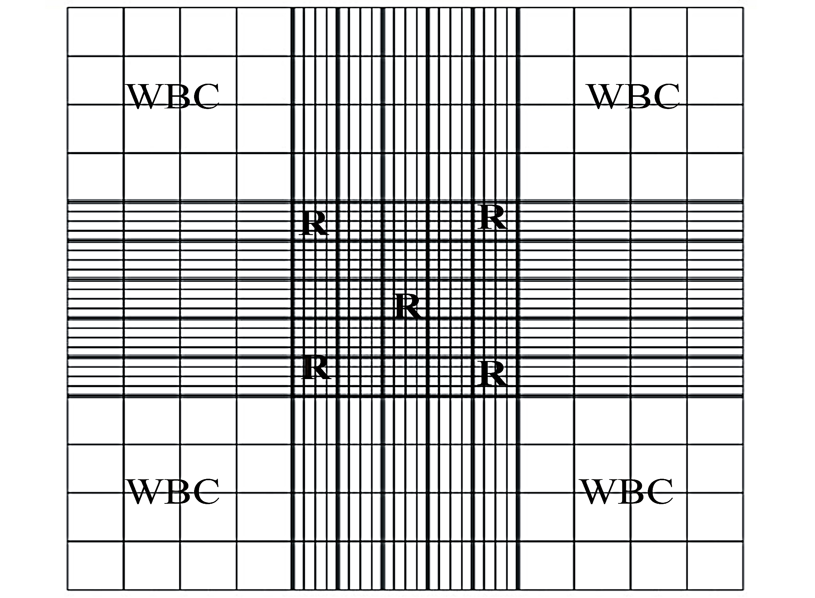

Slide 17
1 mm
Length of the medium square= 1/5 mm
Width of the medium square= 1/5 mm
Depth of the square= 1/10 mm
Area of the medium square=1/5 * 1/5= 1/25 ${mm}^{2 }$
Volume of the medium square= 1/25 * 1/10= 1/250 ${mm}^{3}$
Volume of 5 medium squares= 1/250 * 5= 1/50 ${mm}^{3}$
RBC
RBC
RBC
1 mm
RBC
RBC

Slide 18
0.2 mm
Length of the small square= 1/5*1/4= 1/20 mm
Width of the small square= 1/5*1/4= 1/20 mm
Depth of the square= 1/10 mm
Area of small square=1/20 * 1/20= 1/400 ${mm}^{2 }$
Volume of small square= 1/400 * 1/10= 1/4000 ${mm}^{3}$
Volume of 80 small squares= 1/4000 * 80= 1/50 ${mm}^{3}$
RBC
0.2 mm

Slide 19
Rules for counting
Cells lying within a square are to be counted with that square.
Cells lying on or touching its lower horizontal and left vertical lines are to be counted with that particular square (L shape rule).

Slide 20
Rules for counting
Cells lying on or touching its upper horizontal and right vertical lines are to be omitted from that square because they will be counted with the adjacent squares.

Slide 21
Observations and results
Add up the number of cells in each of the 5 blocks of 16 smallest squares.
A difference of more than 20 between any 2 blocks indicates uneven distribution.

Slide 22
Observations and results
Calculation of dilution factor
The volume of the bulb is 100.
This gives a dilution of 0.5 in 100, or 1 in 200.
The dilution factor = 1/200.
Notes:
When blood is sucked up to the mark 0.5 and is followed by the diluting fluid, the blood enters the bulb first and is followed by the diluent to the mark 101 (RBC pipette), or mark 11 (WBC pipette).
The stem in both pipettes contains only the diluent. Thus, the dilution of the blood occurs in the bulb only.

Slide 23
Observations and results
We can calculate the number of red cells as shown below:
The volume of calculated area= 1/50 ${mm}^{3}$
The dilution factor = 1/200
The diluted volume =1/50 * 1/200 = 1/10000 ${mm}^{3}$
Notes:
Let x be the number of cells in 1/50 mm3 of diluted blood. Cells in 1 mm3 of diluted blood = x × 50 Dilution employed was = 1 in 200 ∴ Number of cells in 1 mm3 of undiluted blood will be = x × 50 × 200 = x × 10000 Thus, adding, 4 zeros in front of x will give the RBC count per 1 mm3 of undiluted blood.

Slide 24
Observations and results
If cell counted = N
RBC count = $\frac{ N∗1 }{\frac{1}{ 10000 }}$
RBC count (${million/mm}^{3}$) = N * 10000
Notes:
Number of cells in 80 smallest squares = 480 These cells are present in 1/50 mm3 of diluted blood.
Dilution employed is = 1 in 200
∴ Number of cells in 1 mm3 of undiluted blood will be = 480 × 50 × 200 = 480 × 10,000 = 4800000, i.e., 4.8 million/mm3.

Slide 25
Observations and results
Express your result as ..... ${million/mm}^{3}$.
The average cell counts and their ranges are:
Males = (4.75 – 6.0) ${million/mm}^{3}$, (5.0 ${million/mm}^{3}$)
Females = (4.0 – 5.5) ${million/mm}^{3}$, (4.5 ${million/mm}^{3}$)

Slide 26
PRECAUTIONS
Observe all precautions described for filling the pipette with blood and diluent, and charging the chamber.
Clean the chamber properly. Once cleaned, do not touch the central part. Any oils left from your fingers on the coverslip or the chamber are fatal to cell counting.

Slide 27
PRECAUTIONS
If there is over-charging or under-charging, wash, clean, dry, and refill the chamber.
Continuously rack the fine adjustment while counting the cells.
Do not draw diluents directly from the stock bottle as it may contaminate the solution with cells.

